Slide 1

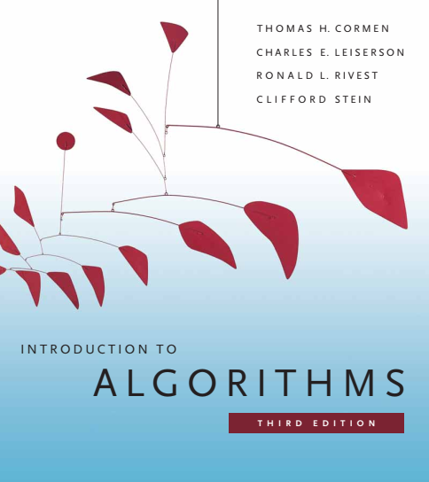
Design and Analysis of Algorithms
Dr. Sajid Iqbal
sajidiqbal.pk@gmail.com
Reference Book
Introduction to Algorithms 3rd Edition By Thomas H. Cormen et. al.
https://mitpress.mit.edu/books/introduction-algorithms-third-edition
COMEDXD

Slide 2
The HeapSort
Sorting using heap Data Structure

Slide 3
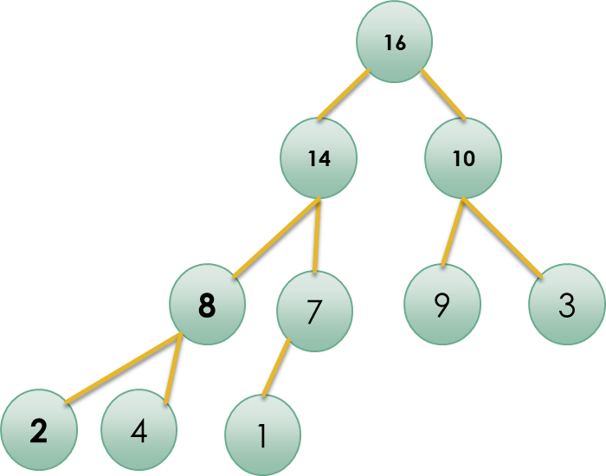

Introduction
Heapsort uses heap data structure to sort a list of items
Heapsort is an application of heap
We will use $Max_Heap$property ($A\left[Parent\left[i\right]\right]≥A[i]$) to sort elements in ascending order
We will use $BUILD−MAX−HEAP$ procedure to build a max-heap on the input array $A[1,…,n],$where $n = A.length$
In max-heap, maximum element is present at root location i.e. $A[1]$
It can be placed in its proper location by exchanging it with $A[n]$
Remove the $A[n]$ element to get heap of size $A.heap_size−1$
New root can violate the max-heap property
So adjust the $max⁡_heap$property by calling $Max_Heapify(A,1)$
Repeat the process from step $1$.
[ 1 2 3 4 7 8 9 10 14 16]

Slide 4
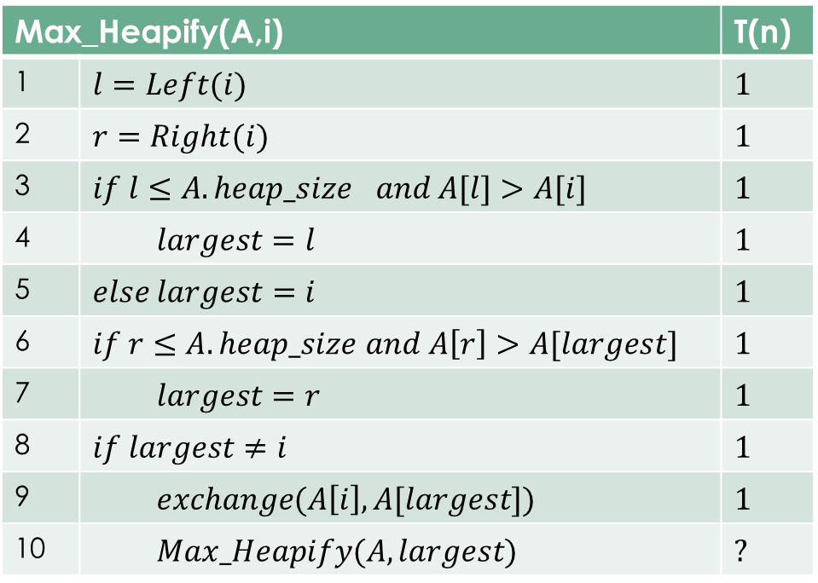

Max_Heapify Time Complexity
Time to fix one element: $θ(1)$
Time to maintain the $max⁡_heap$property on a subtree rooted at one of the children of node $i$.
The children’s subtrees each have size at most $\frac{2n}{3}$ (the worst case)
$T(n)=T(2n/3)+θ(1)$
By case 2 of the master theorem
$T\left(n\right)=O\left(logn\right)=O(h)$
Max_Heapify(A,i) |  | T(n)
1 | $$l=Left(i)$$ | $$1$$
2 | $$r=Right(i)$$ | $$1$$
3 | $$if l≤A.hea{p_size}_{}and A[l]>A[i]$$ | $$1$$
4 | $$largest=l$$ | $$1$$
5 | $$else largest=i$$ | $$1$$
6 | $if r≤A.heap_size$ $and A\left[r\right]>A[largest]$ | $$1$$
7 | $$largest=r$$ | $$1$$
8 | $$if largest≠i$$ | $$1$$
9 | $$exchange(A\left[i\right], A[largest])$$ | $$1$$
10 | $$Max_Heapify(A,largest)$$ | $$?$$

Slide 5

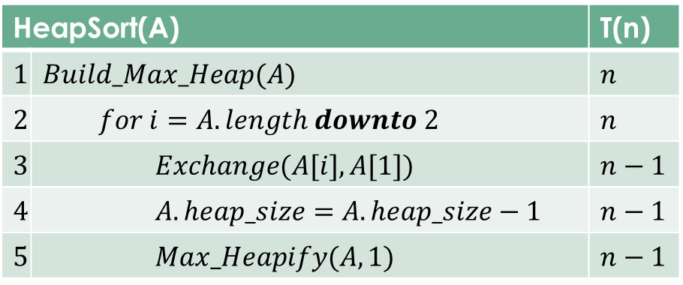
Heapsort Time Complexity
$T\left(n\right)=n+n+\left(n−1\right)+\left(n−1\right)+(n−1)(?)$
$T\left(n\right)=4n−2+\left(n−1\right)\left(?\right)$
$T\left(n\right)=4n−2+\left(n−1\right)\left(O(logn\right)$)
$T\left(n\right)≤4n−2+cnlogn −clogn$
$T\left(n\right)≤cnlogn+4n−clogn−2$
$T\left(n\right)=O(nlogn)$
HeapSort(A) |  | T(n)
$$1$$ | $$Build_Max_Heap(A)$$ | $$n$$
$$2$$ | $$for i=A.length downto 2$$ | $$n$$
$$3$$ | $$Exchange(A[i],A[1])$$ | $$n−1$$
$$4$$ | $$A.heap_size=A.heap_size−1$$ | $$n−1$$
$$5$$ | $$Max_Heapify(A,1)$$ | $$n−1$$

Slide 6
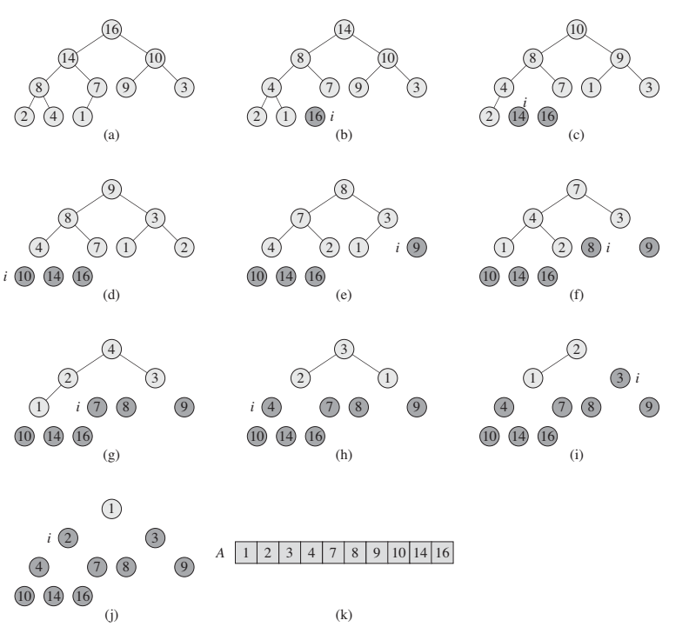
Heap Sort Illustration

Slide 7
Python Implementation of Heap Sort
def Build_Max_Heap(A): global heap_size heap_size=len(A) for i in range(len(A)//2,-1,-1): Max_Heapify(A,i) print(A) return A
4
def Max_Heapify(A,i): l=Left(i) r=Right(i) if(l<heap_size and A[l]>A[i]): largest=l else: largest=i if(r<heap_size and A[r]>A[largest]): largest=r if largest!=i: t=A[i] A[i]=A[largest] A[largest]=t Max_Heapify(A,largest)
import numpy as np heap_size=0 largest=0
3
1
2
def Parent(i): return i//2 def Left(i): return 2*i def Right(i): return 2*i+1
5
def Heap_Sort(A): global heap_size A=Build_Max_Heap(A) for i in range(len(A)-1,0,-1):
# swaping of two variables A[i],A[0]=A[0],A[i] heap_size = heap_size - 1 Max_Heapify(A, 0) return A
#Driver Code A=np.asarray([4,1,3,2,16,9,10,14,8,7]) print(A) A=Heap_Sort(A) print(A)
6

Slide 8

Thanks for watching
Dr. Sajid Iqbal
Assistant Professor
Department of Computer Science
Bahauddin Zakariya University, Multan
sajidiqbal.pk@gmail.com
YouTube Channel: COMEDXD
Allah Hafiz

